Slide 1
ARTIFICIAL INTELLIGENCE
Chapter # 1

Slide 2
Table of Contents
1. What is Artificial Intelligence?
2. The AI problems
3. The underlying assumptions
4. What is an AI Technique

Slide 3
What is Artificial Intelligence?

Slide 4
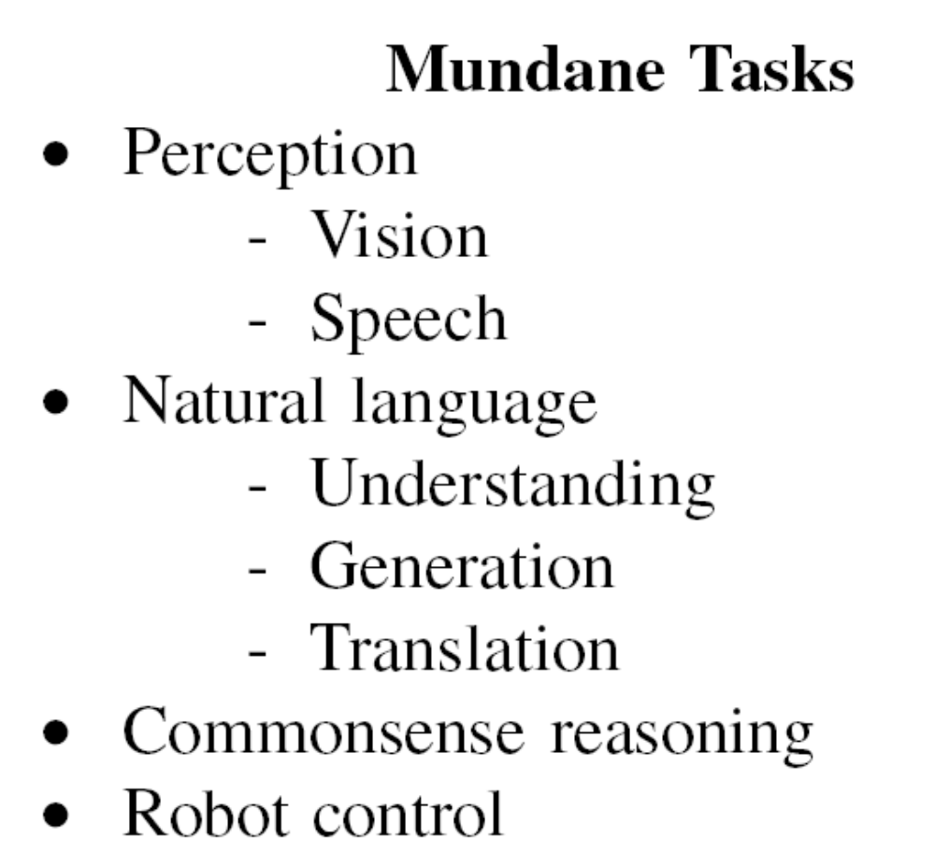
Some of the Task Domains of
Artificial Intelligence

Slide 5
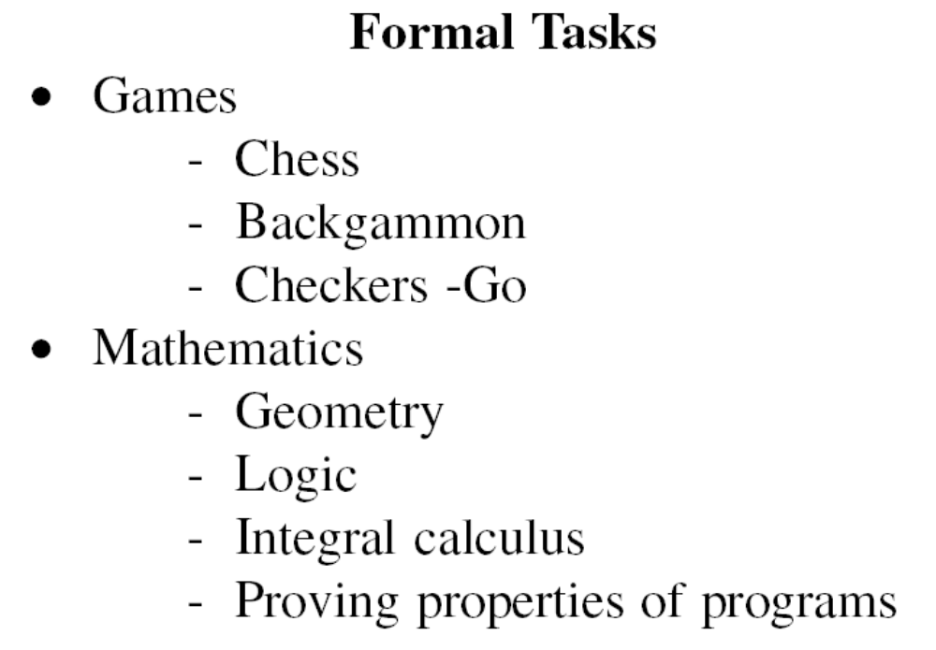
Some of the Task Domains of
Artificial Intelligence

Slide 6
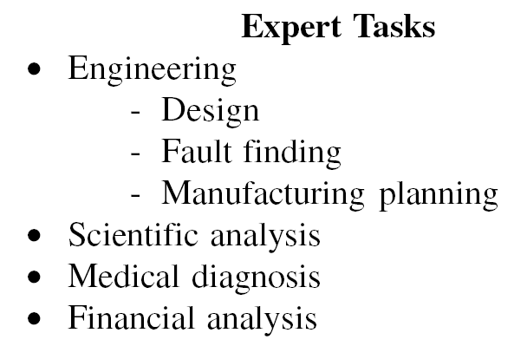
Some of the Task Domains of
Artificial Intelligence

Slide 7
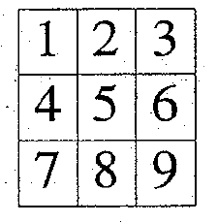
Tic Tac Toe 1
Board
Move table
→ A vector of 19,683 elements

Slide 8
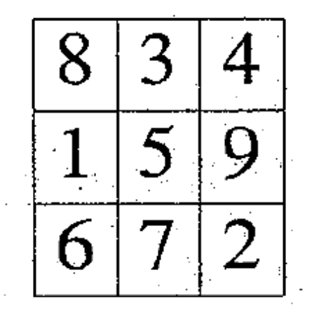
Tic Tac Toe 2
Board

Slide 9
Question Answering Example
Mary went shopping for a new coat. She found a red one she really liked. When she got it home, she discovered that it went perfectly with her favorite dress.
→ Q1 : What did Mary go shopping for?
→ Q1 : What did Mary find that she liked?
→ Q1 : Did Mary buy anything?

Slide 10
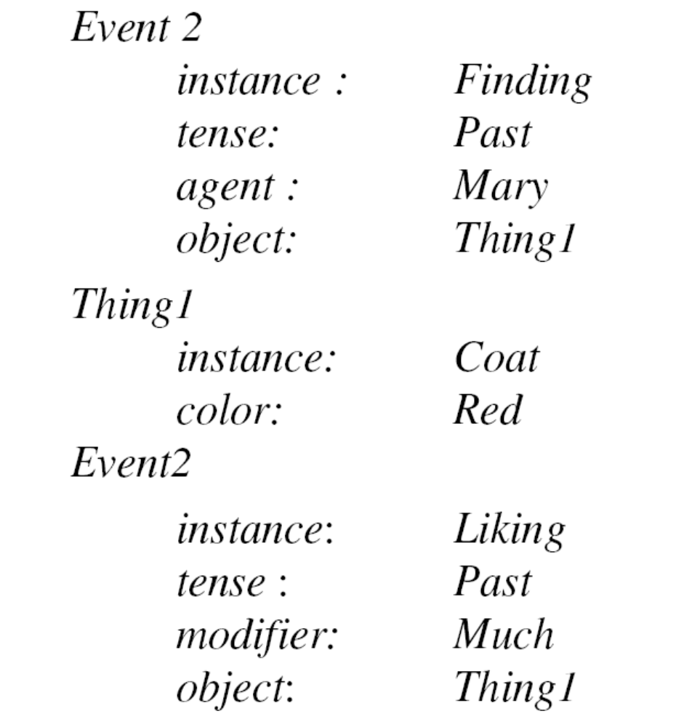
A Structure Representation of a Sentence

Slide 11
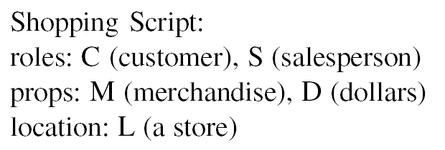
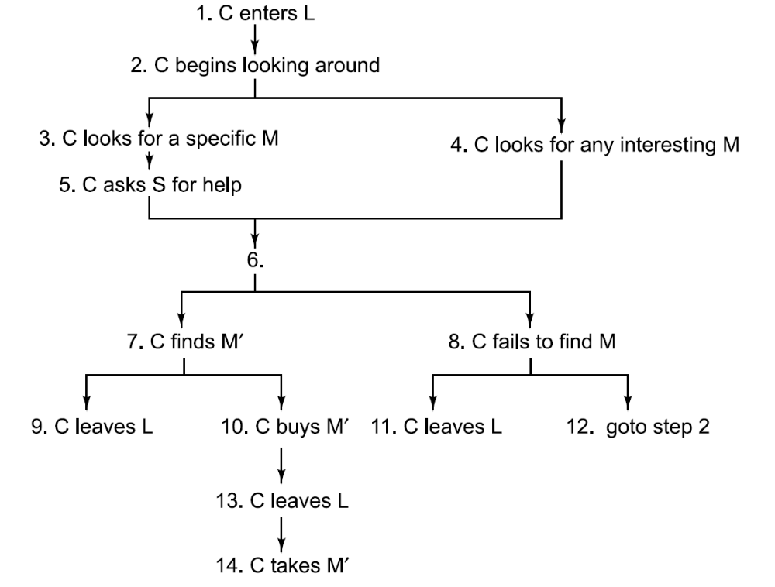
A Shopping Script

